Slide 1

MCTS Guide to Microsoft Windows 7
Chapter 4
Managing Disks

Slide 2
Objectives
Understand common disk technology and related partition styles
Understand basic and dynamic disk storage technology
Understand typical disk management tools and tasks
Understand partition and volume management
Understand VHD disk management

Slide 3
Disk Technology
Can be categorized by:
  How it is connected to the computer
  How it is presented to Windows 7
Consider these disk technologies:
  Internal Disk
  External Disk
  Virtual Hard Disk (VHD)
  Multiple Disks as One Logical Disk

Slide 4
Internal Disk
Typical internal disk interface types include IDE, SATA, and SCSI
Firmware built in to the computer
  Designed to recognize supported internal disk storage and boot from at least one of the installed internal disk devices

Slide 5
External Disk
Used to connect removable portable disk storage
Typical external disk interface types include USB, eSATA, SCSI, and FireWire (IEEE 1394)
Best practice
  Avoid using external disks as a location for operating system files

Slide 6
Virtual Hard Disk (VHD)
Windows 7 is the first version of Windows to natively support Virtual Hard Disk operations
Files can be stored in a VHD storage location just like any other disk technology
  Once the VHD is made available in the Windows 7 operating system
Only Windows 7 Ultimate and Windows 7 Enterprise support the ability to natively boot from a VHD

Slide 7
Multiple Disks as One Logical Disk
Logical disk appears to the Windows 7 operating system as if it is one disk drive
Windows 7 can combine multiple disks as one logical disk using software built into the operating system
Multiple disks can be connected to an advanced hardware based RAID disk controller
  Physical drives are managed by the disk hardware controller directly
  Management operations are done with the software that comes with the third-party hardware

Slide 8
Partition Styles
Windows 7 can organize data on disk drives using one of several partition styles
When a blank disk is first configured for use by Windows, one of these styles must be selected:
  Master Boot Record (MBR)
  GUID Partition Table (GPT)

Slide 9
Master Boot Record (MBR)
Master Boot Record (MBR)
  Standard used for accessing hard disk data
BIOS firmware initializes the computer
Computer must find and load the operating system
MBR includes the boot sector and a data table
  Identifies how sections, or partitions, of space on the disk are used to store files
MBR disk technology is limited to organizing partitions on a single logical drive up to 2 terabytes (TB)
Hard disk
  Bulk storage device that is limited to a maximum storage capacity
  Managed by part of the operating system
    That acts as a storage provider to applications and the operating system itself

Slide 10
GUID Partition Table (GPT)
Hardware capacity has grown and technology has improved
GUID Partition Table (GPT)
  Replacement for MBR specifications
Partitions of a GPT disk are each identified with a unique coded label called a GUID (Globally Unique Identifier)
Only computers designed with EFI/UEFI firmware running the 64-bit Editions of Windows 7 can boot from a disk drive using the GPT partition style

Slide 11
Types of Disk Partitions
Empty space on the drive can be organized using two different methods in Windows 7:
  Basic disk storage
  Dynamic disk storage

Slide 12
Basic Disk Storage
Basic disk
  Hard disk initialized to use basic storage technology
Basic disk storage
  Simple means to logically organize disk space
Basic disk can have its space organized into one or more defined areas of storage called partitions
  Partition is identified by size and type of data it holds
Partition information is stored in the partition table of the MBR

Slide 13
Basic Disk Storage (cont'd.)
Primary partition
  Stores files that are used to load an operating system
  Active partition
    Capable of starting an operating system
    Each disk can have one active primary partition
Extended partition
  Takes the place of one of the primary partitions that can be created on the basic disk
  No drive letter or folder path assigned to it
  Reserves space for and holds logical partitions

Slide 14
Basic Disk Storage (cont'd.)
Logical partition
  Can only be created using the free space inside an extended partition
  Can be formatted using a file system to store files
  Drive letters can be assigned

Slide 15
Dynamic Disk Storage
Dynamic disk
  Hard disk initialized to use dynamic storage
Dynamic disk storage
  Provides the flexibility to logically organize disk space across one or more disk drives
  First introduced with Windows 2000
On dynamic disks
  Blocks of space are called volumes
    Details about the volumes are stored in a hidden database on the dynamic disk

Slide 16
Dynamic Disk Storage (cont'd.)
Dynamic disk technology is not appropriate for removable disk storage
  A dynamic volume must be aware of the other dynamic volumes on the computer
Simple volume
  Exists on just a single dynamic disk
  Is not fault tolerant

Slide 17
Dynamic Disk Storage (cont'd.)
Spanned volume
  Exists on two or more dynamic disks
  Links blocks of space from multiple dynamic disks
  Not fault tolerant
Striped volume
  Minimum of two dynamic disks, maximum of 32
  Links blocks of space from multiple dynamic disks
  Striped volume is a RAID 0 solution

Slide 18
Dynamic Disk Storage (cont'd.)
Mirrored dynamic volume
  Can only be created with two dynamic disks
  Block of space on one dynamic disk must be matched to an identically sized block of space
    On a second dynamic disk
  Redundant Array of Independent Disks (RAID) 1
  Fault tolerant
RAID 5 dynamic volume
  Can only be created with three or more dynamic disks
  Fault tolerant

Slide 19
Disk Management Tools
Windows 7 tools
  Disk Management
  DiskPart

Slide 20
Disk Management
Disk Management console
  MMC console snap-in
  Part of the Computer Management utility
  Provides a graphical interface
    Allows a member of the Administrators group to observe and make changes to the computer’s disk configuration
  Allows changes to be made interactively
    Usually takes effect immediately without restart

Slide 21
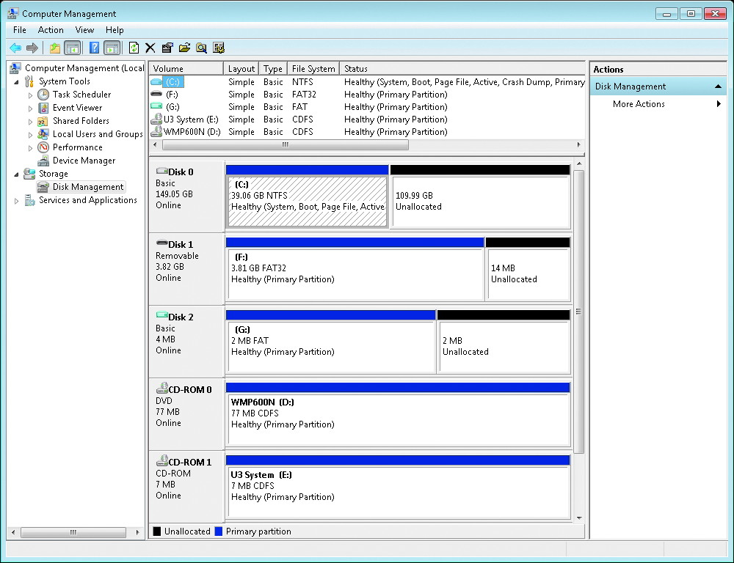
Disk Management Screen

Slide 22
DiskPart
Command-line tool
  Allows disk and volume operations to be performed:
    From a text-based screen interactively
    From a scripted file
Operations are driven by a sequence of commands
  Each command has object to focus its action on
Commands can execute:
  As part of a scheduled task
  As an automated response on the local computer or remotely on another computer

Slide 23
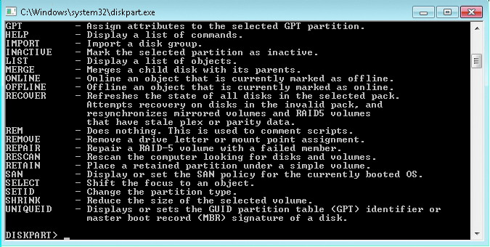
DiskPart Command Line Window

Slide 24
Disk Management Tasks
Major activities for proper disk administration include:
  Preparing hard disks
  Disk cleanup
  Checking disk health
  Defragmenting disks
  Moving disks
  Converting disk types
  Managing fault tolerance

Slide 25
Preparing Hard Disks
Scan for New Hardware Changes
  The hardware used to connect hard disk to the computer may consist of many individual components
  Device Manager utility detects device driver issues
    Triggers a manual scan for hardware changes if the plug and play system did not detect the change
Scan for Disks
  OS may not see the new disks immediately
  Windows 7 can be forced to manually recheck all of the connected hardware

Slide 26
Preparing Hard Disks (cont'd.)
Initializing New Disks
  Disk cannot be used until it is initialized with a fundamental structure
  Disk Management console can trigger the process manually

Slide 27
Disk Cleanup
Cleanup can be for one or all users
Disk Cleanup utility helps the user identify common sources of data
  That can be purged from the disk to recover space
Disk Cleanup More Options tab
  Allows the user to trigger additional methods to recover disk space

Slide 28
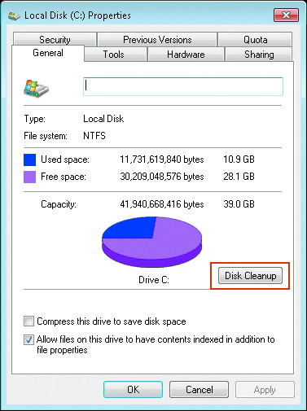
Local Disk Properites Dialog Box

Slide 29
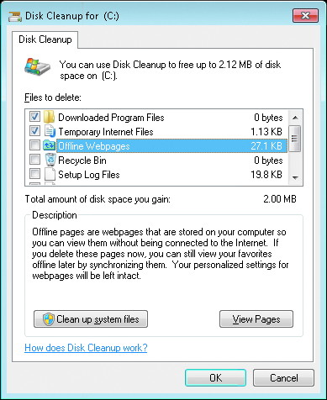
Disk Cleanup Dialog Box

Slide 30
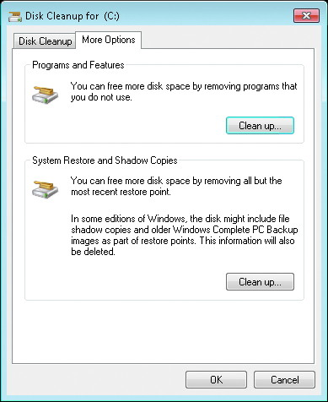
Disk Cleanup Dialog Box

Slide 31
Checking Disk Health
Hard disk can have damaged physical areas
  Corrupt data stored in those locations
Damaged area is typically reported as bad sectors
Disk health can be checked by selecting the Check Now button on the Tools tab
  Of the properties of a volume
chkdsk command-line utility is also available for use at the command prompt or from a script

Slide 32
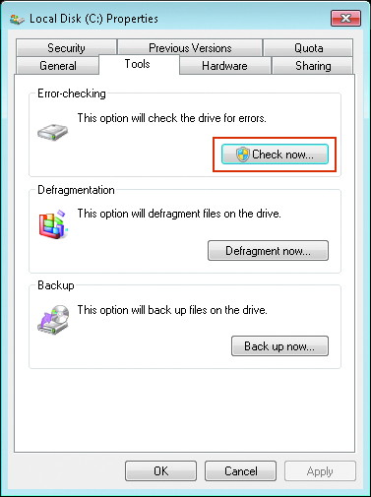
Checking Disk Health

Slide 33
Defragmenting Disks
Files are stored in partitions and volumes on the physical disk
Sectors and clusters used by a file can become distributed throughout the physical disk’s surfaces
  Can have a significant impact on performance
Defragmentation is a “best effort” utility that tries to improve the layout of files within a disk
Defragmentation utility does not add a significant drain on the computer’s performance
  While it rewrites files on the disk

Slide 34
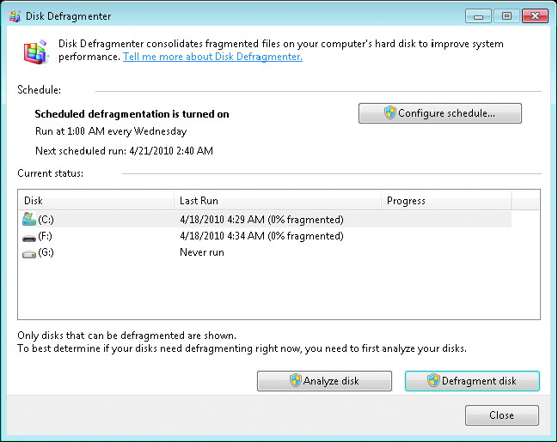
Scheduling Defragmentation of Disks

Slide 35
Moving Disks
Physical disks can be moved from one computer to another
  However, the partitions and volumes they contain require special consideration
Drive letters assigned to a basic disk’s logical and primary partitions will be retained
  If they are not already in use on the current local computer
Dynamic disk database stores the name of the computer to which the dynamic disk belongs

Slide 36
Moving Disks (cont'd.)
Disk Management console reports the status of the disk as a Foreign Disk
  When it recognizes that the disk does not belong to that computer
To import a disk you must use the Import Foreign Disk option from the Disk Manager utility

Slide 37
Converting Disk Types
Versions of Windows 7 that support dynamic disks can convert between basic and dynamic disk
  Using the Disk Management console or the DiskPart command-line utility
When a basic disk is converted to a dynamic disk
  All primary and logical partitions it contains are converted to simple volumes
When a dynamic disk is converted to a basic disk
  All volumes contained on that disk are destroyed

Slide 38
Managing Fault Tolerance
Basic disks are not fault tolerant by design
Dynamic disks support two types of fault-tolerant volumes: mirrored and RAID-5
If a single disk fails in a mirrored set
  Mirror can be broken using the Disk Management console or the DiskPart command-line utility
If a single disk fails in a RAID-5 array of disks
  RAID-5 volume will continue to operate in a degraded mode

Slide 39
Partition and Volume Management
Partition describes reserved regions of space on a basic disk
Volume describes regions of reserved space on a dynamic disk
Not all dynamic volume types are supported in Windows 7

Slide 40
Partition and Volume Management (cont'd.)
Volume Type | Dynamic Disk | Basic Disk
Primary Partition | No | Yes
Extended Partitions | No | Yes
Logical Partitions | No | Yes
Simple | Yes | No
Spanned | Yes | No
Striped | Yes | No
Mirrored | Yes | No
RAID-5 | No | No

Slide 41
Partition and Volume Management (cont'd.)
Common administrative tasks for partitions and volumes include:
  Creating partitions and volumes
  Deleting partitions and volumes
  Extending partitions and volumes
  Shrinking partitions and volumes

Slide 42
Creating Partitions and Volumes
Use either the Disk Management snap-in or the DiskPart command-line utility
  Requires Administrator privileges
Creating Basic Disk Partitions
  See Table 4-2
Creating Dynamic Disk Partitions
  See Table 4-3

Slide 43
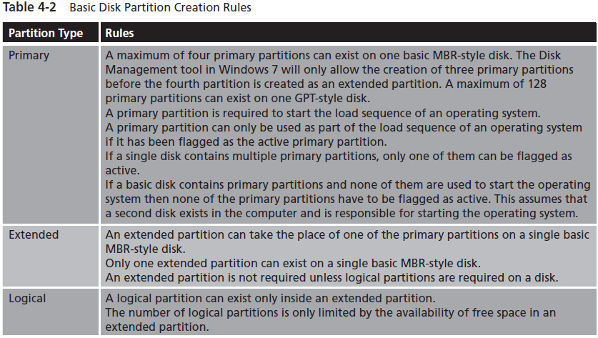
Creating Partitions and Volumes (cont'd.)
See page 179 in book

Slide 44
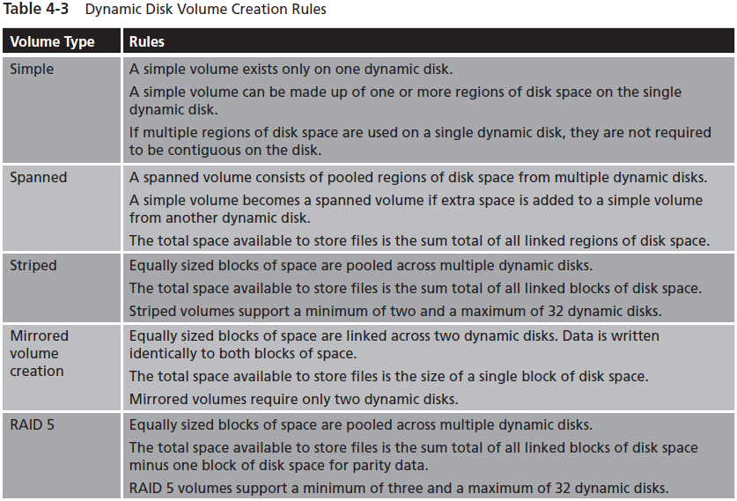
Creating Partitions and Volumes (cont'd.)
See page 180 in book

Slide 45
Deleting Partitions and Volumes
Use the Disk Management MMC console or the DiskPart command-line utility
  Requires Administrator-equivalent user account
Deleting a volume or partition results in data loss
Extended partitions cannot be deleted unless all of the logical partitions they contain are deleted first

Slide 46
Extending Partitions and Volumes
Use the Disk Management MMC console or the DiskPart command-line utility
  Requires an Administrator-equivalent user account
Extending Basic Disk Partitions
  Extended partitions cannot be further extended
Extending Basic Disk Partitions (cont'd.)
  Considerations
    System and boot partitions can be expanded
    Free space must be:
      Available that is not assigned to another partition
      Contiguous with the partition being expanded
    Partition being expanded must have either no file system or NTFS
    Partition expansion is immediate; no reboot needed
Extending Dynamic Disk Volumes
  Not all dynamic volumes can be extended

Slide 47
Extending Partitions and Volumes (cont'd.)
Extending Dynamic Disk Volumes (cont'd.)
  Considerations
    System and boot volume can be expanded
    Simple volume can be extended using any free disk space on the same physical disk
    Free disk space used to extend a simple volume does not have to be contiguous
    If a simple volume is extended with free space from another physical disk, it becomes a spanned volume
    Spanned volume cannot be used to create a larger striped or fault-tolerant volume
    Volume expansion is immediate; no reboot needed

Slide 48
Shrinking Partitions and Volumes
Use the Disk Management snap-in or the DiskPart command-line utility
  Requires an Administrator-equivalent user account
Rules
  Free space must exist within the partition
  Files are automatically moved within the partition as required
  Some files, such as the swap file or shadow copy storage, cannot be moved
  Partition or volume either has no file system or is formatted with NTFS
  If a high number of bad sectors detected on the disk, the shrink may be unsuccessful

Slide 49
Virtual Disk Management Tasks
Windows 7 introduces native support for working with Virtual Hard Disks (VHDs):
  Creating VHDs
  Attaching VHDs
  Detaching VHDs
  Advanced VHD Management

Slide 50
Creating VHDs
VHD in Windows 7 is created as a single file on an attached physical disk drive
Use the Disk Management snap-in or the DiskPart command-line utility
  Requires an Administrator-equivalent user account
To create a VHD, you must specify the following information:
  Location
  Virtual Hard Disk Size
  Virtual Hard Disk Format

Slide 51
Attaching VHDs
VHD must be attached, or mounted, to be available to the operating system and the user
Use the Disk Management snap-in or the DiskPart command-line utility
  Requires an Administrator-equivalent user account
Only time a VHD automatically mounts as the computer starts
  Special case where Windows 7 is configured to boot from a VHD file

Slide 52
Detaching VHDs
VHD must be detached, or dismounted, to make it unavailable to the operating system and the user
Use the Disk Management snap-in or the DiskPart command-line utility
  Requires an Administrator-equivalent user account
When a computer is restarted, the VHD files currently attached automatically detach

Slide 53
Advanced VHD Management
Disk Management snap-in is limited in what management operations can be done with VHD files
DiskPart command line utility allows for advanced management operations such as:
  Compact VHD
  Expand VHD
  Detail VHD Properties

Slide 54
Summary
Windows 7 supports basic and dynamic disk technology to organize data into partitions and volumes
Disk management activities include preparing new disks for use, cleaning up wasted space, checking the disk health, minimizing access delays, and moving disks
Disk type limits partitions and volumes created on a disk
  Once a partition or volume is created, it is possible to extend and shrink them if specific conditions apply

Slide 55
Summary
Virtual Hard Disks (VHDs) are natively supported by Windows 7
  Can be managed as a basic disk once the VHD is attached in the operating system

